Slide 1
Assignment 1-Implementation of Backpropagation and Training a Palindrome Network
Aditya Pande | 22M2108
Balbir Singh | 22M0747
Tarun Bisht | 23D0386
Vivek Kumar Trivedi | 22N0457
Date - 19 Feb, 2024

Slide 2
Problem Statement
Input: 10-bit String (of numbers)
Output: 1 if Palindrome, 0 otherwise

Slide 3
Architecture and Hyperparameter details
INPUT LAYER
Σ
σ
No of neurons : 10 Input layer is FULLY CONNECTED to next layer
Σ
σ
Σ
σ
HIDDEN LAYER
No of neurons : 2 Activation : Sigmoid
σ
INPUT LAYER
HIDDEN LAYER
OUTPUT LAYER
HYPERPARAMETER
OUTPUT LAYER
Learning Rate: 0.1
Batch Size: 32
Momentum β: 0.9
OverSampling: duplicate 20 times Minor class
No of neurons : 1 Threshold : 0.5 for predicting 1
Activation : Sigmoid
σ
BIAS IS USED IN HIDDEN AS WELL AS OUTPUT LAYER

Slide 4
Overall performance
Accuracy (Total and class-wise)
Total = 100%
Class0 Non- Palindrome (NP)= 100%
Class1 Palindrome(P) = 100%
Confusion Matrix
Classification Report
 |  | Precision | Recall | f1-score |  | support
Class0: Non - Palindrome |  | 1.00 | 1.00 | 1.00 |  | 992
Class1: Palindrome |  | 1.00 | 1.00 | 1.00 |  | 32
Accuracy | Total |  |  |  | 1.00 | 1024
 | Class0: NP |  |  |  | 1.00 | 992
 | Class1: P |  |  |  | 1.00 | 32
True Value
1 | 0
True Positive | False Positive
32 | 0
False Negative | True Negative
0 | 992
1
Predicted Value
0

Slide 5
Interpretability of middle layer
OBSERVATIONS
Wo Anti Symmetry around axis
+w11
+w12
+w13
+w14
+w15
-w15
-w14
-w13
-w12
-w11
bo Same value for both neurons
W1 Both weights are the same
Σ
CONSEQUENCES
PALINDROME
wo
w1
b1
Zup
bo
Aup
similar
Zlow
bo
Alow
similar
bo
NON PALINDROME
-wo
w1
Aup
Close to O or 1
Σ
Alow
Close to 1 or O

Slide 6
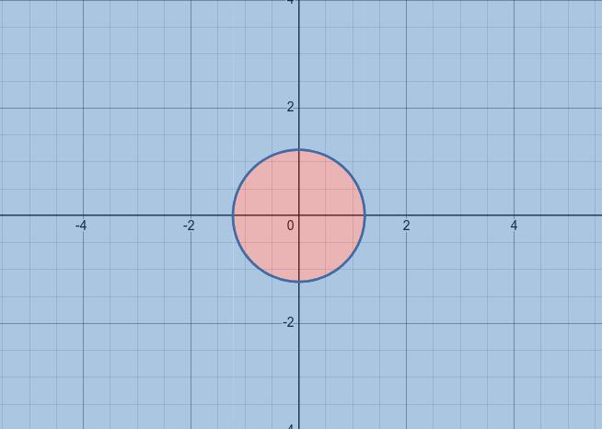
Learnings
NON PALINDROME REGION
σ(bo)
Aout
w1 + b1
PALINDROME REGION
Aout
2 x w1 x σ(bo) + b1
NOTE : σ(bo) > 0.5
OUTER NETWORK JUST learns this decision boundary as above
Two neuron in hidden layer is required if activation is sigmoid and no skip connection allowed.
One neuron is sufficient in case of mod or square activation in hidden layer OR with skip connections
As data is imbalance, oversampling minority class improves performance.
Weighted BCE loss did not improved performance.

Slide 7
Evaluation Scheme
Correct implementation of BP from scratch: 10 marks (show the code parts that implement weight change rules)
Theory of BP clarity: 10
Overall Performance: accuracy >=90: 10 marks; 80-89: 9; 70-79: 8; 60-69: 7; 50-59: 40-49: 5; 30-39: 4. And so on
Interpretability of middle layer: 10
Demo -10

Slide 8
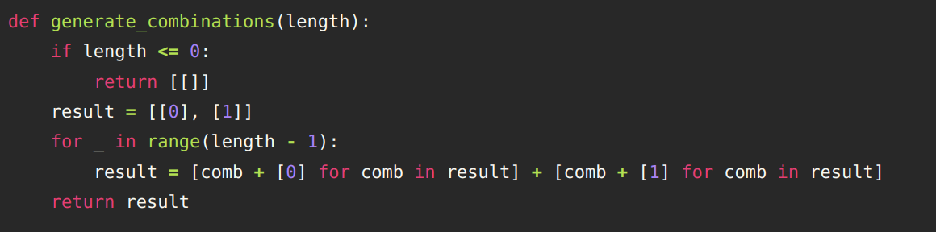
APPENDIX: Input representation
Each input x is a 10 x 1 numpy array
Each entry of the input array form the input of the first (input) layer of the neural network
The function generate_combinations generates all the possible 10 bit lists
I
I
O
O
I
I
O
O
O
O
O
O
I
O
I
I
I
O
I
I
Example
Non -Palindrome
Example
Palindrome
Function to generate all 10 bit strings
PLEASE NOTE : This slide is not part of the presentation. This is a REFERENCE slide

Slide 9
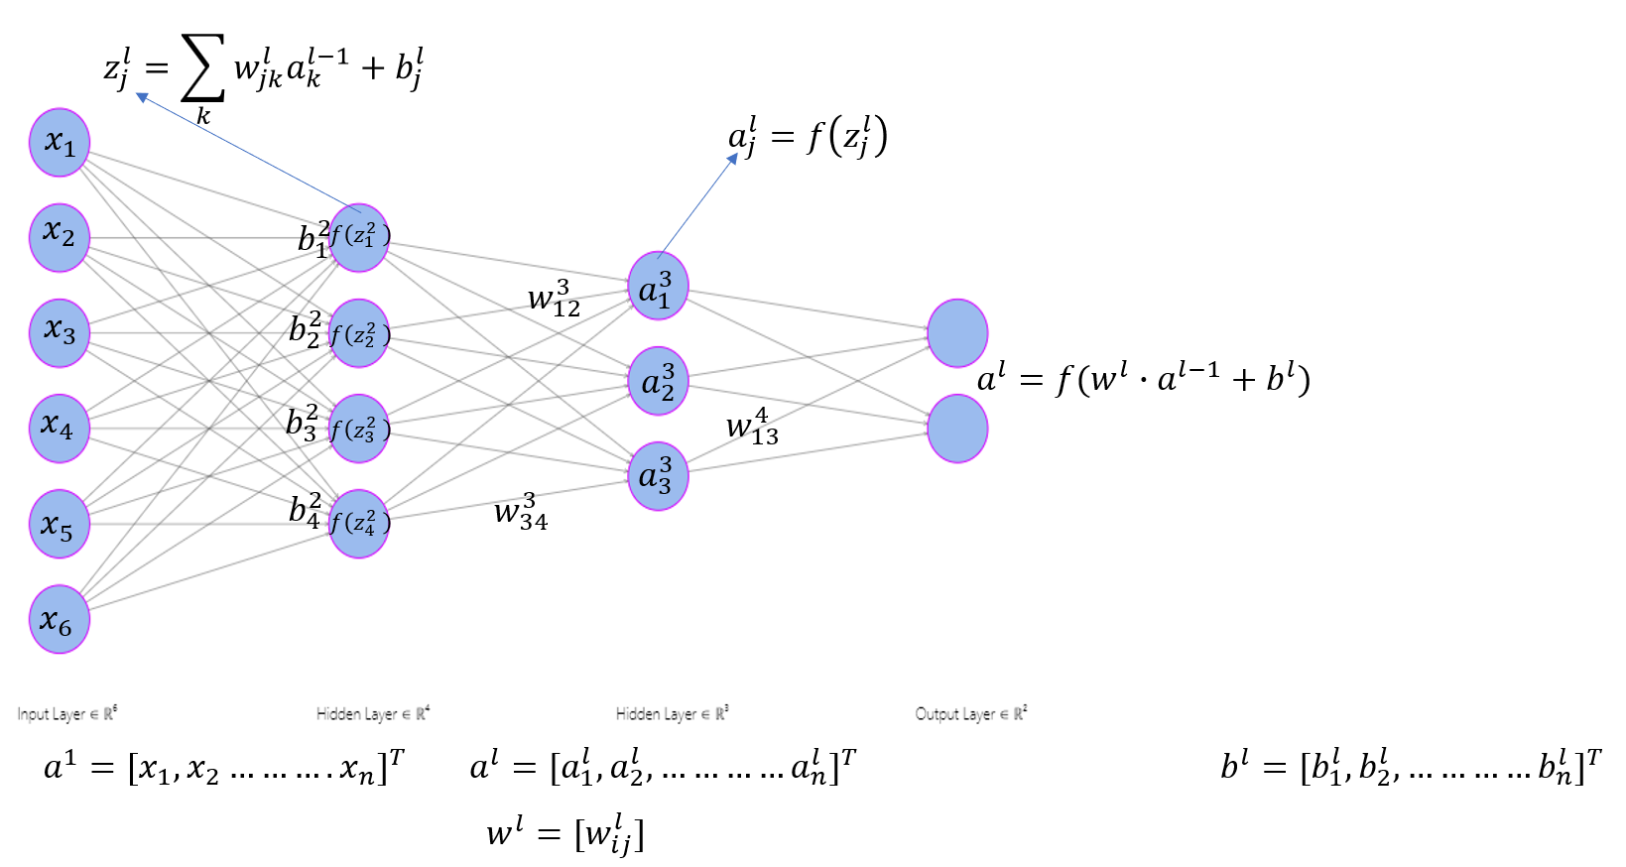
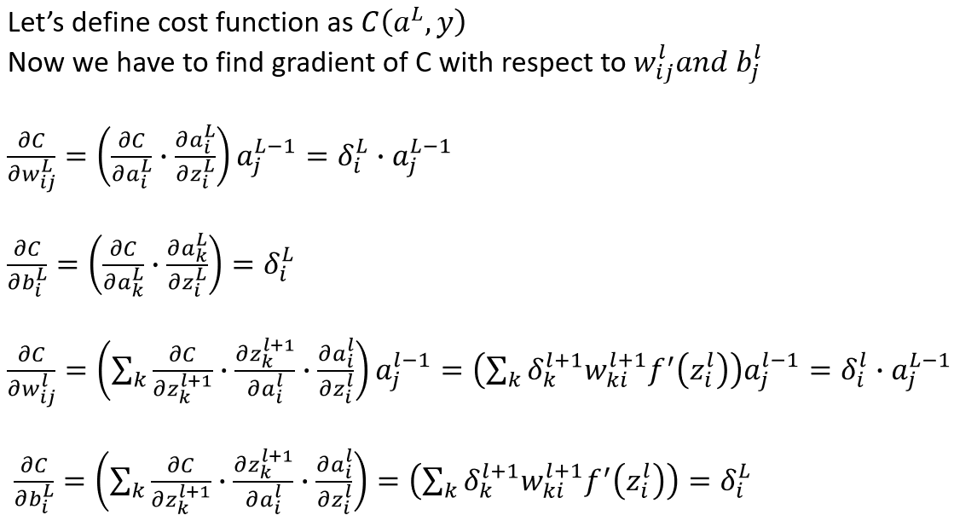
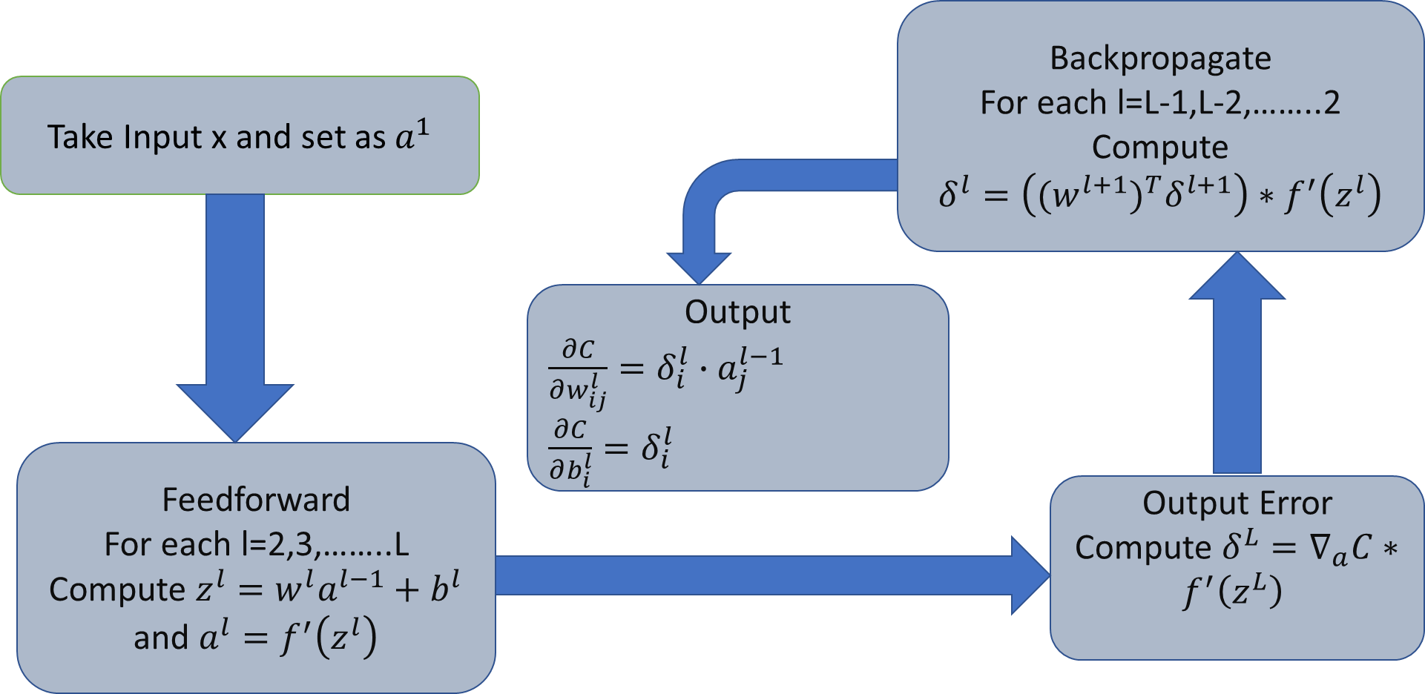
APPENDIX: Theory of BP
PLEASE NOTE : This slide is not part of the presentation. This is a REFERENCE slide

Slide 10

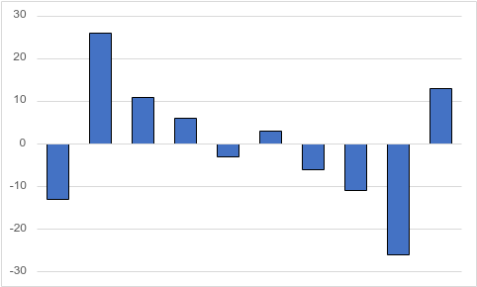
APPENDIX: One Neuron hidden layer (square activation)
Σ
Σ
σ
INPUT LAYER
HIDDEN LAYER
OUTPUT LAYER
PLEASE NOTE : This slide is not part of the presentation. This is a REFERENCE slide

Slide 11
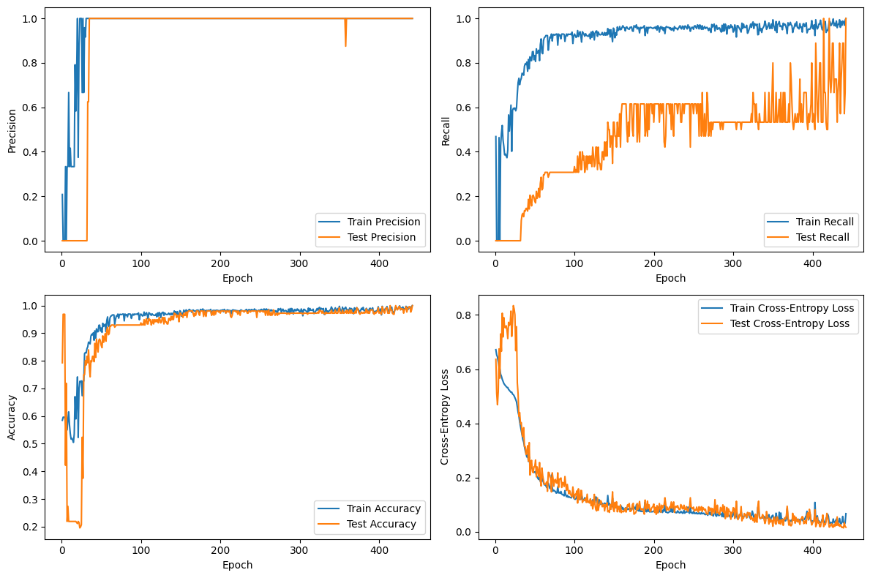
APPENDIX: Plots
PLEASE NOTE : This slide is not part of the presentation. This is a REFERENCE slide

